Slide 1
Adamas audio: A technical break down
By Hemanto Bairagi

Slide 2
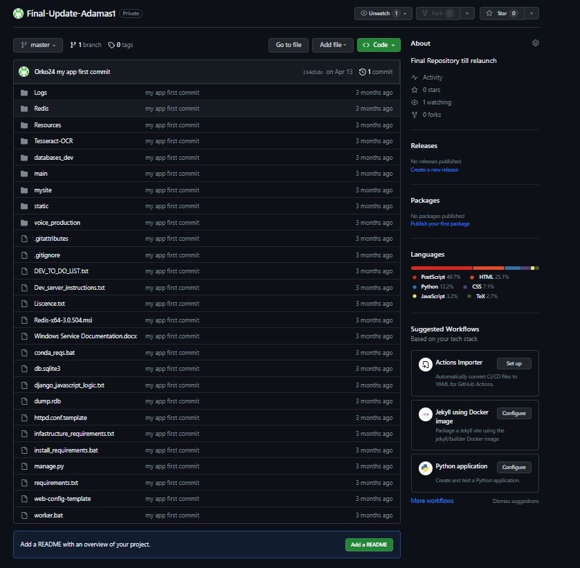
Architecture

Slide 3
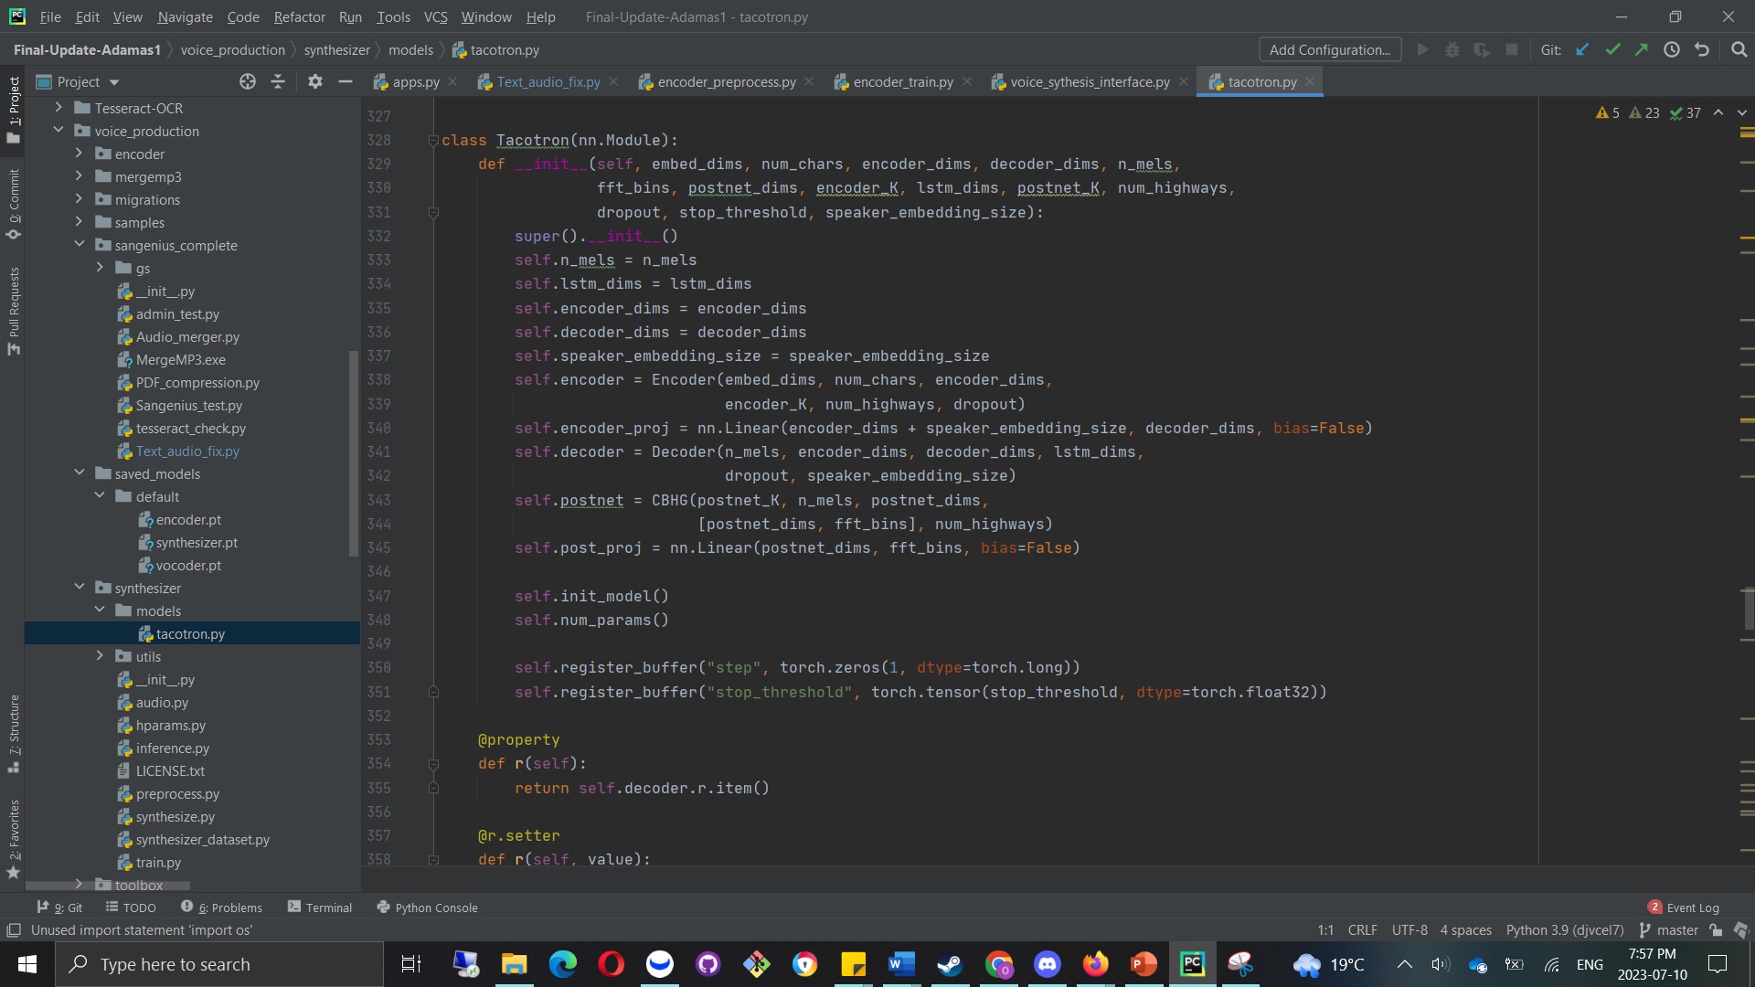
Machine Learning model: Tacotron

Slide 4
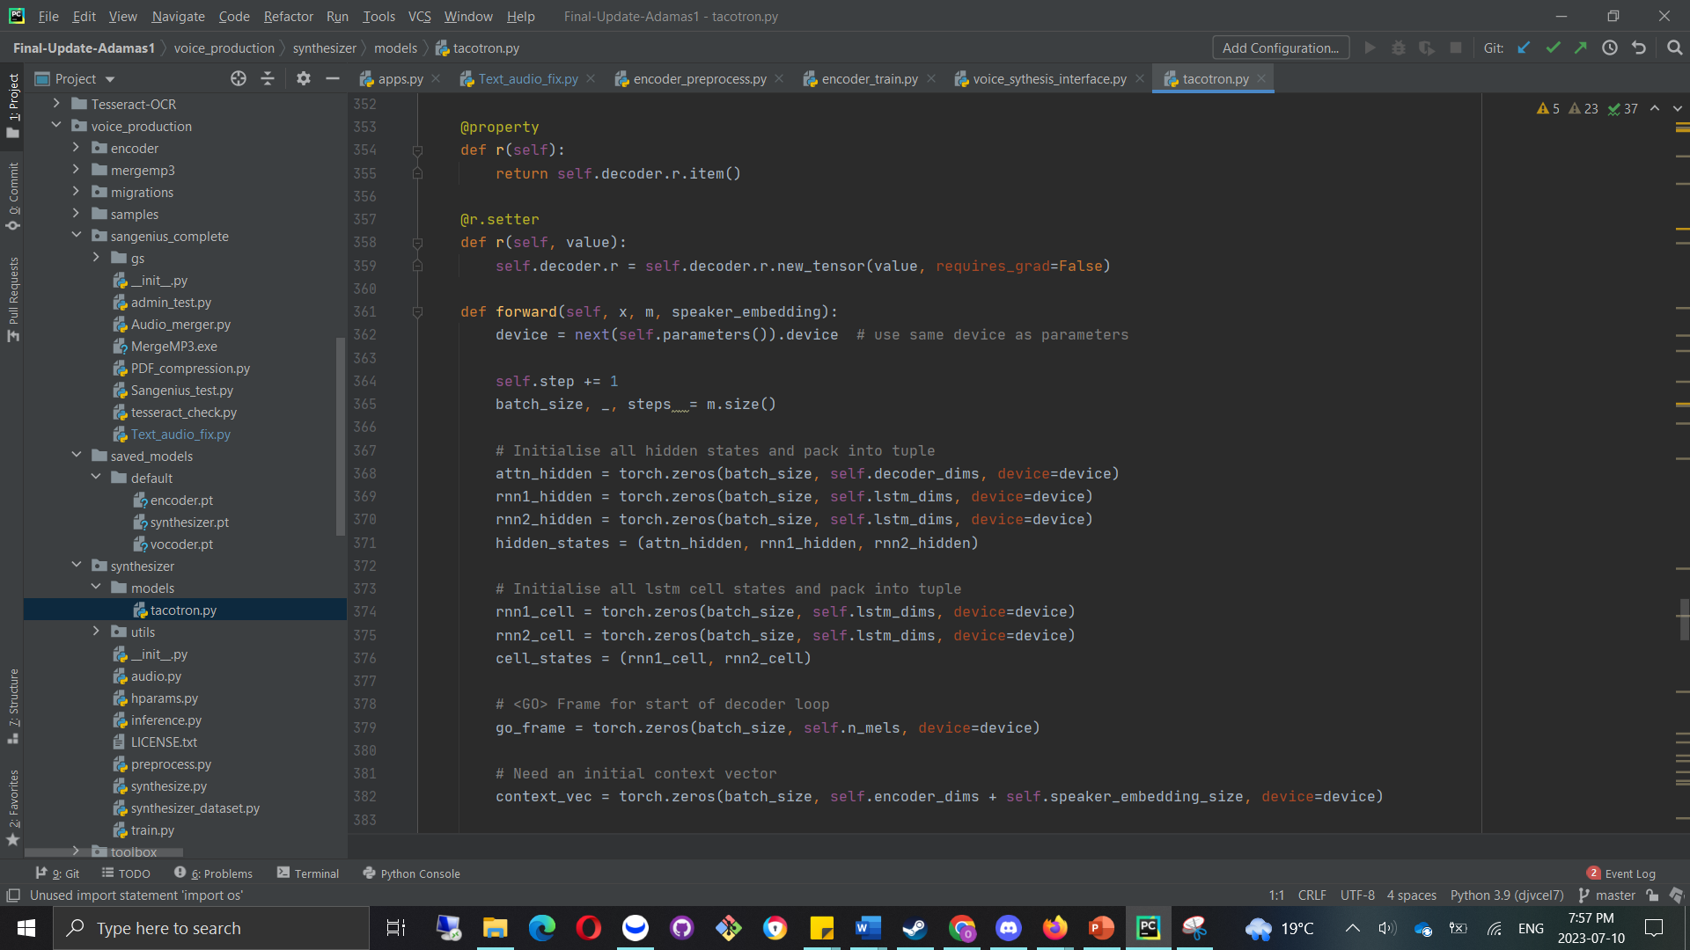
Machine Learning model: Tacotron

Slide 5
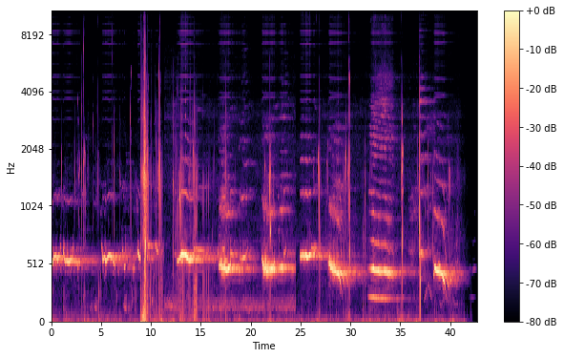
Mel Spectrographs

Slide 6

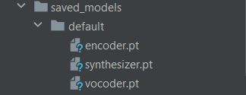
Phonetic DATA
Stored as Audio model, i.e. Latin characters to Mel spectrographs.
Each phonetic data have certain frequencies.
Frequencies can be mapped to incoming data flow

Slide 7
Phonetic DATA
Audio data mapped to encoder data.
Modifies Mel spectrogram data using Tacotron model in the encoder data.
Produce’s synthesizer data (ref hand notes) and creates synthetic voice model to be mapped onto pre-trained model.
Produces Vocoder, Text to Speech Engine.

Slide 8
OCR
https://github.com/tesseract-ocr/tesseract
Piggy backs off Tesseract Engine coming from data pipelines.

Slide 9
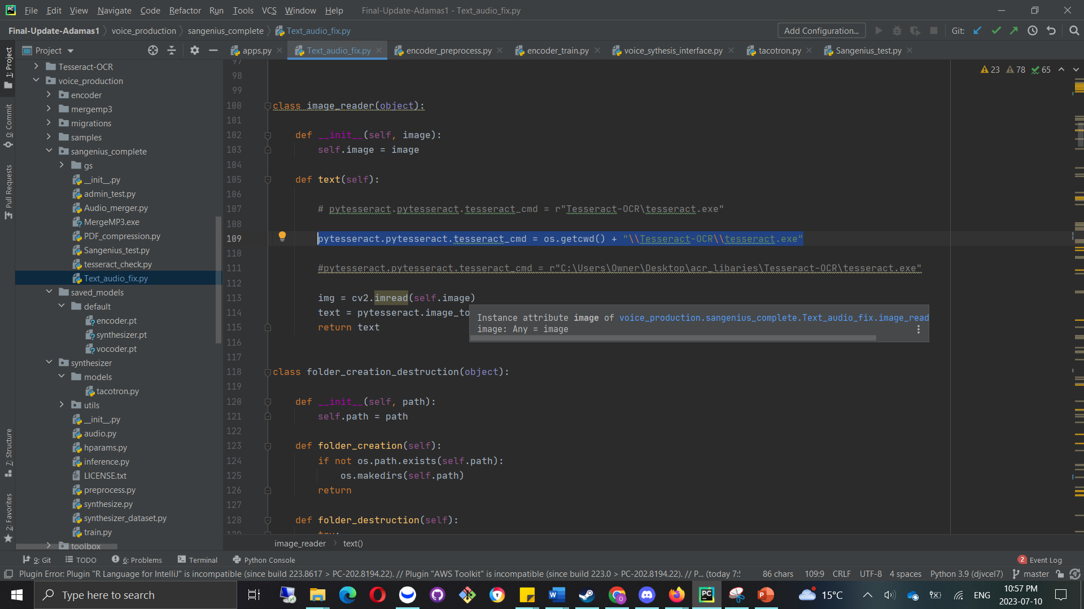
OCR

Slide 10
OCR
REST API → JSON pipeline (request) → Django Middleware → Tesseract Engine → Python String → Vocoder → Text to Speech → Data Product (Audiobook) → Django Middleware → JSON pipeline → REST API (response)

Slide 11
CONVENTIONAL audio
Sorting and PDF processing algorithms.
ETL algorithms like PDF to image conversion.
Fed into OCR algorithm.
Fed into Pyttext Engine: https://pyttsx3.readthedocs.io/en/latest/engine.html
Audiobook produced

Slide 12
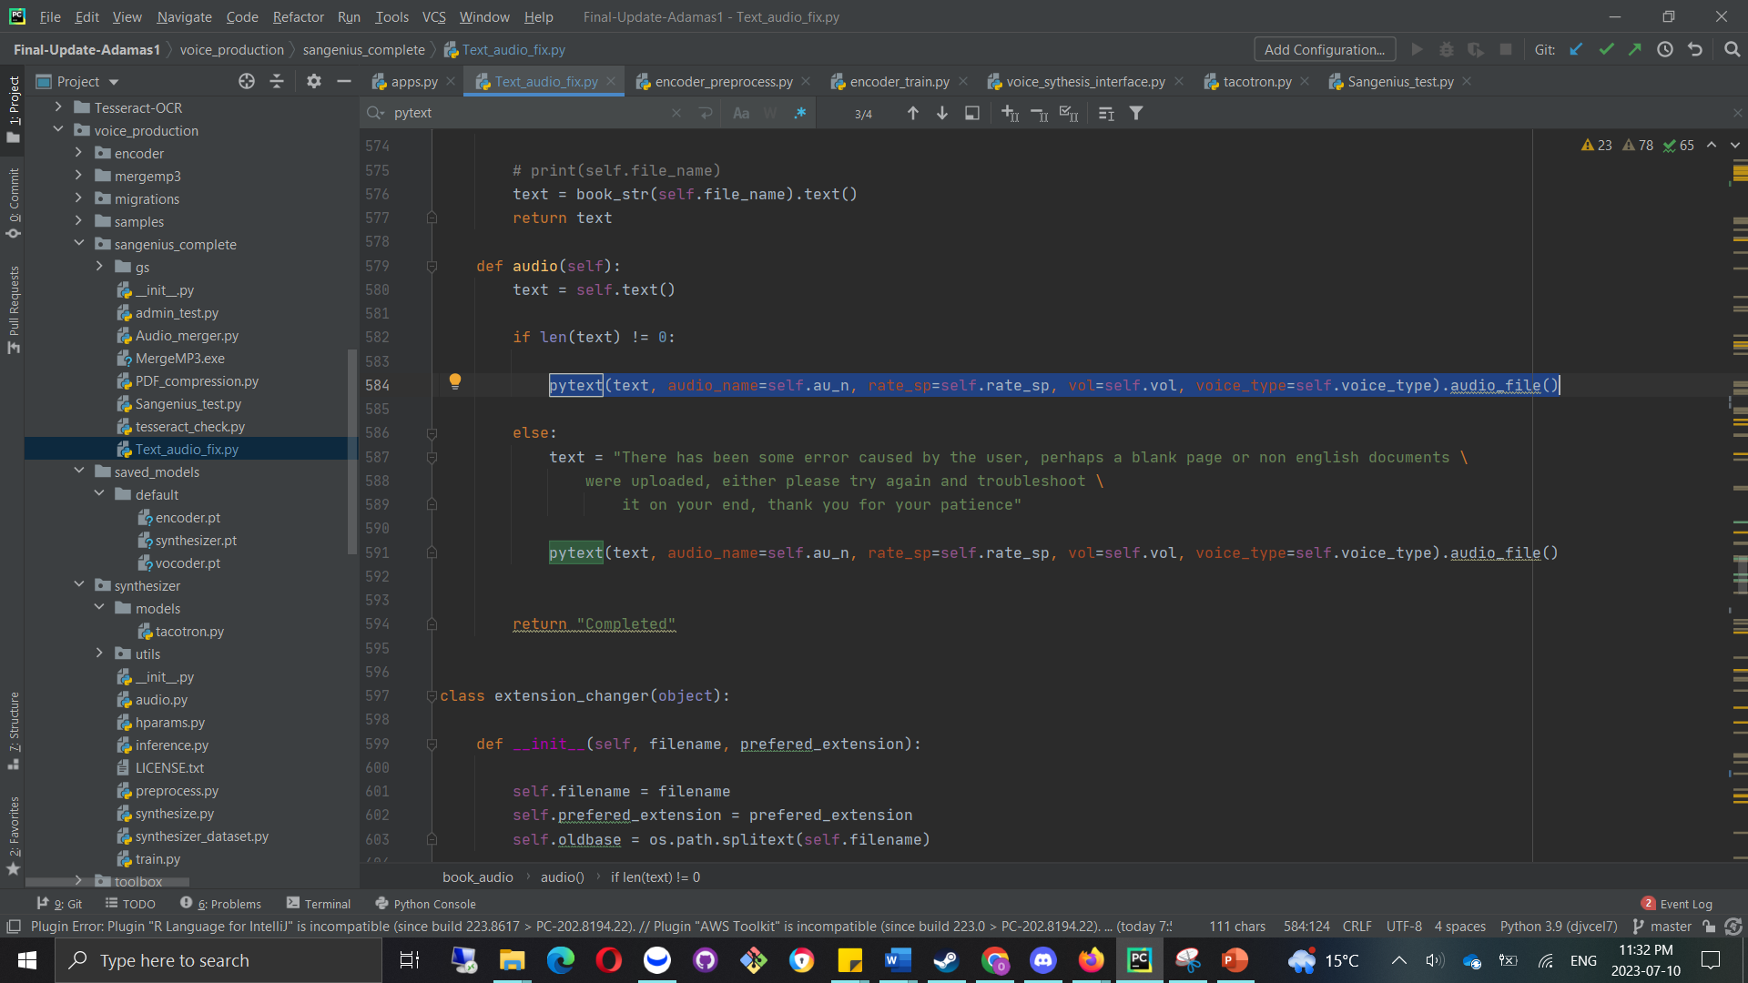
CONVENTIONAL audio

Slide 13
PDF compression algorithm
Data pipeline → Ghost Script Engine → Compressed PDF
https://www.ghostscript.com/
Compressed PDF → ETL Algorithms → OCR process

Slide 14
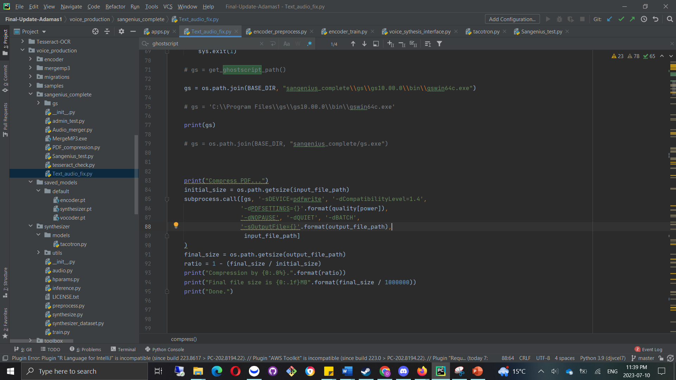
PDF compression algorithm

Slide 15
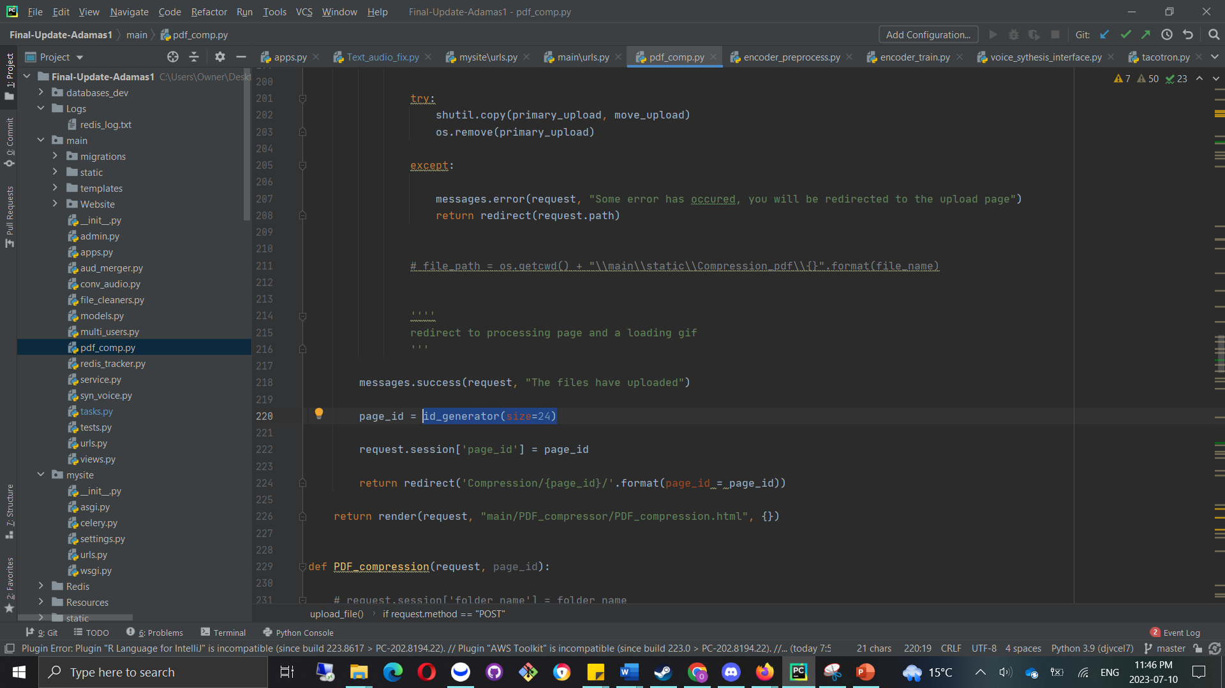
Data Governance System

Slide 16
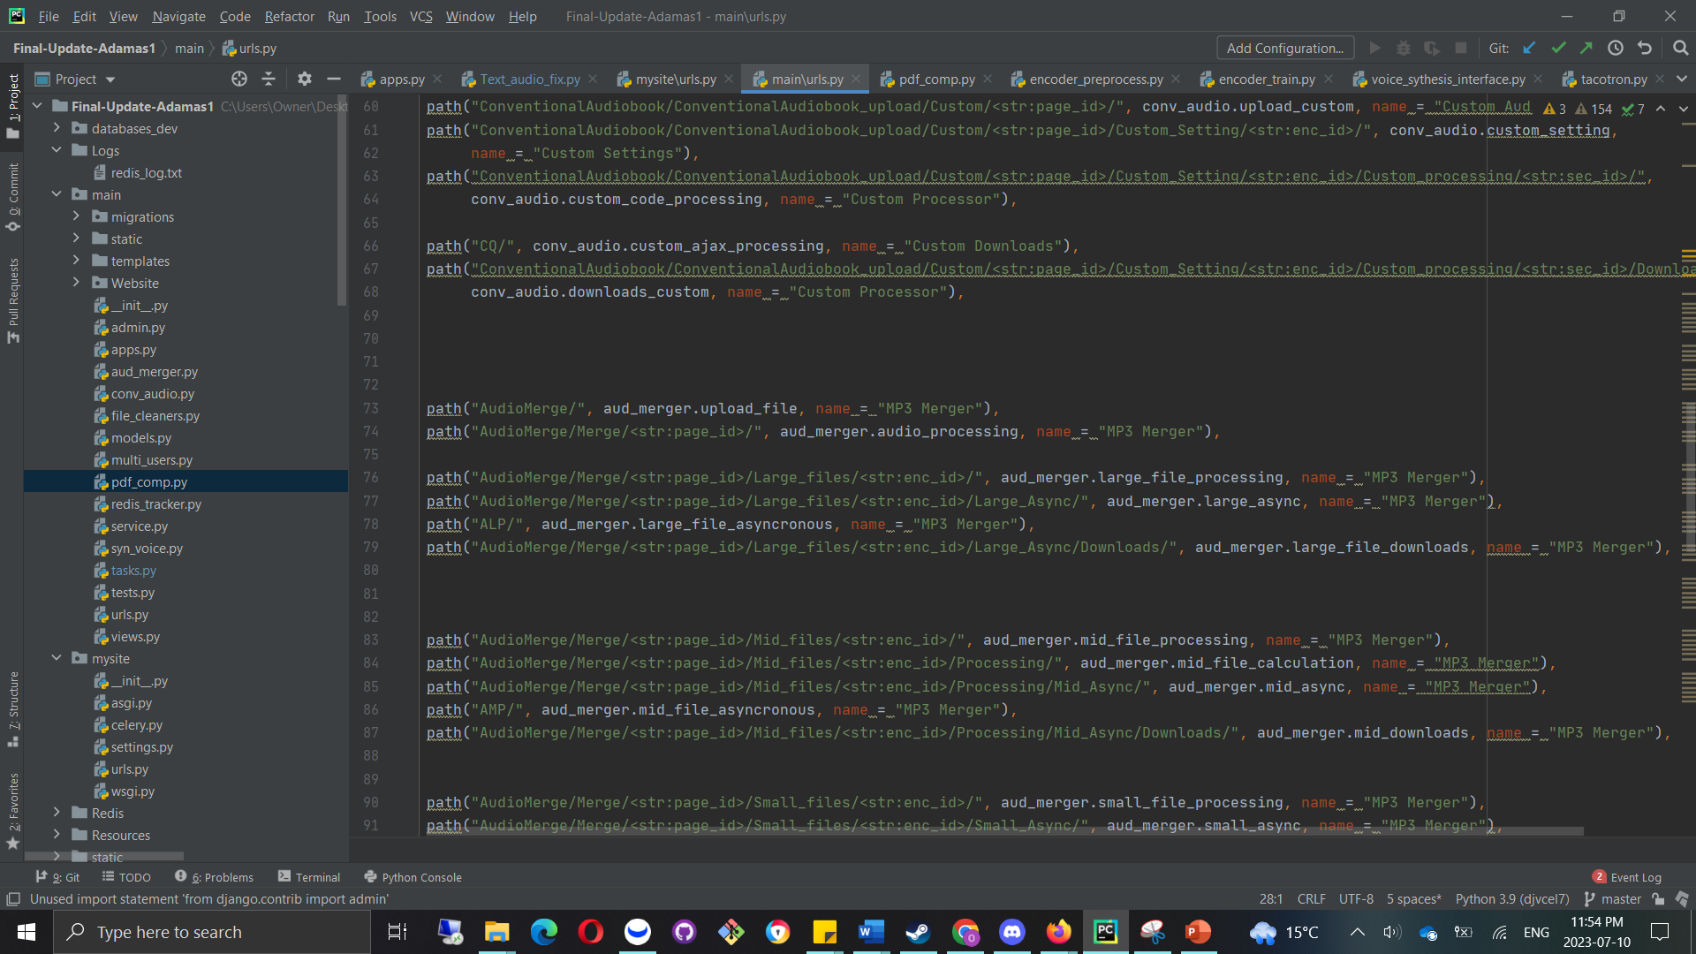
Data Governance System

Slide 17
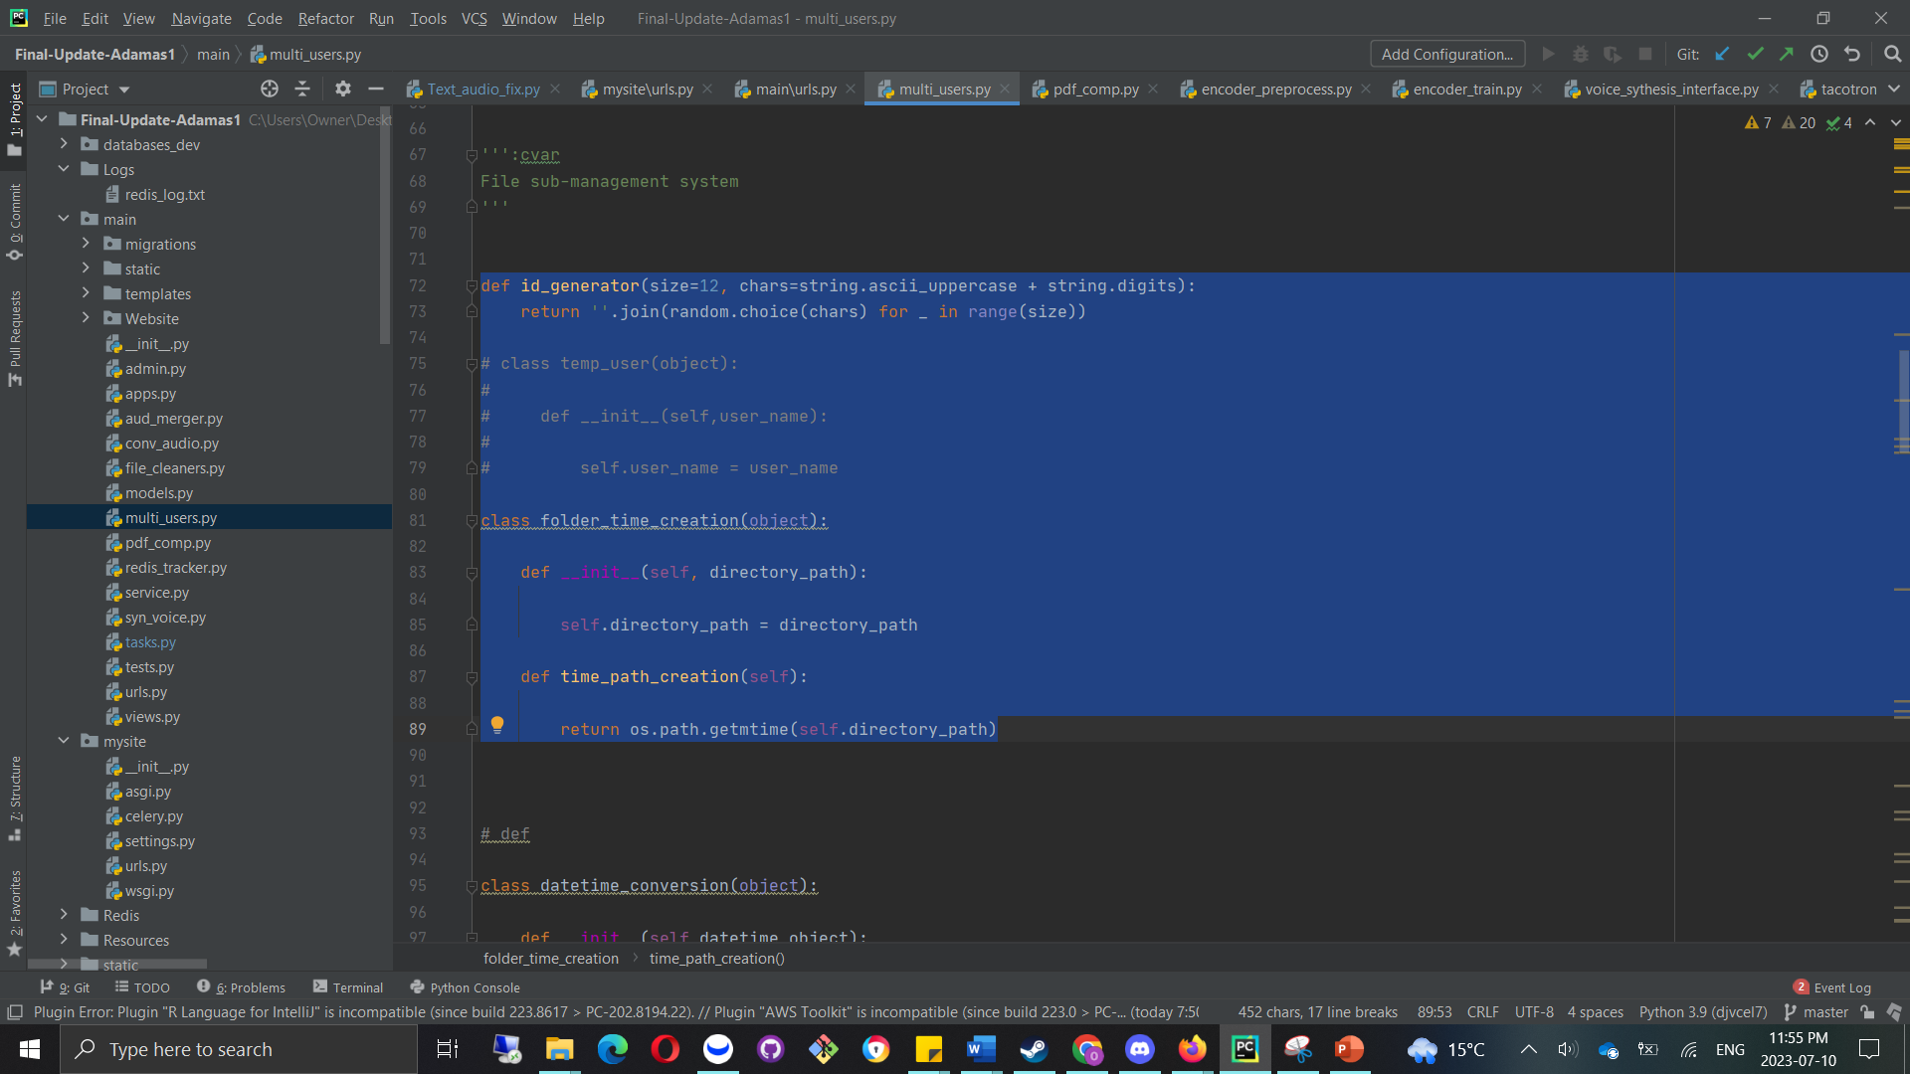
Data Governance

Slide 18
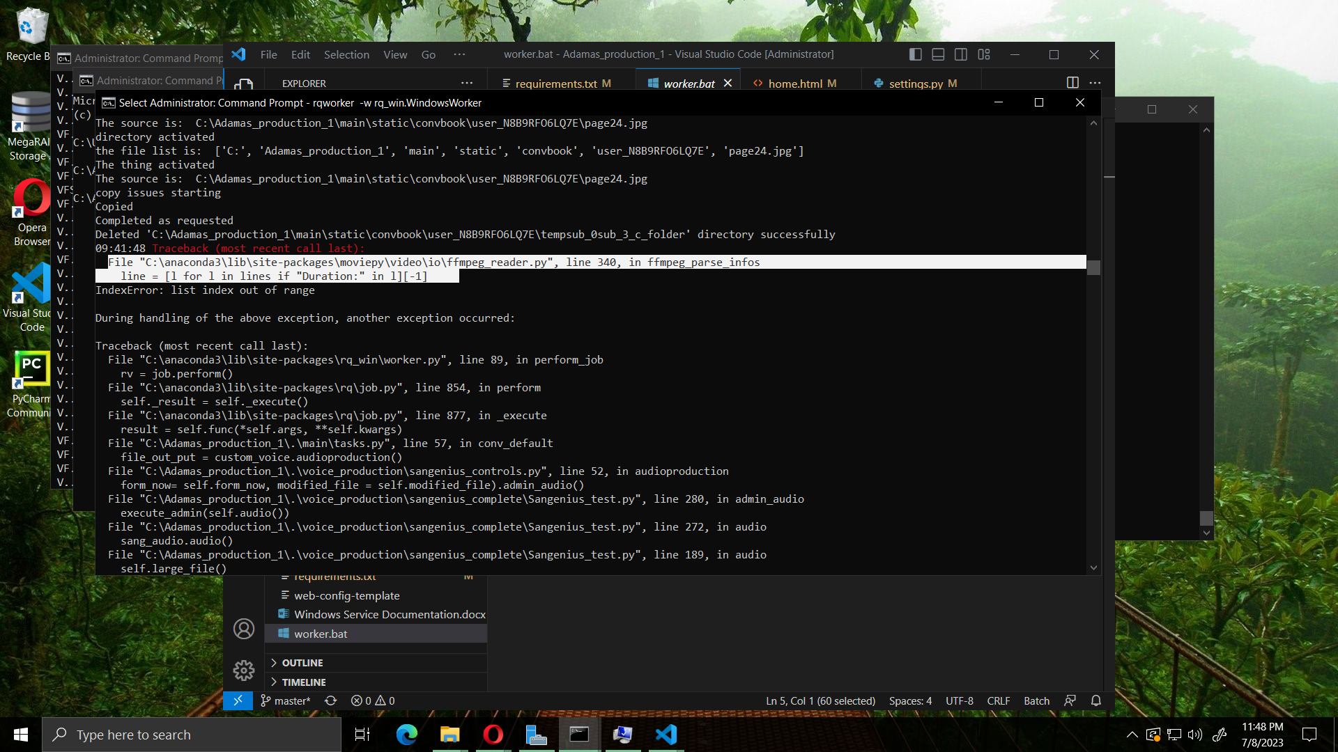
Server Issues

Slide 19
Server Issues
FFMPEG server clashes with Windows OS Server, and incoming Django Apache pipeline data pipeline.
Solution: Make a Golang Alternative and use python subprocess similarly to the GhostScript architecture to replace Audio Merger code.
Replaced by code similar to this repository: https://github.com/hyacinthus/mp3join

Slide 20
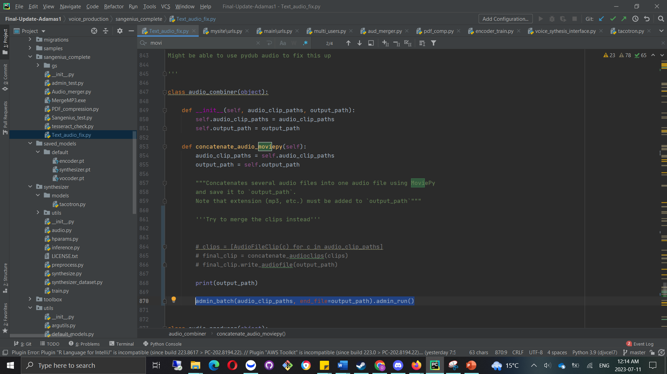
Server Issues

Slide 21
Conclusion
Server issues, fix Golang.
Test Automation and Asynchronous Processing at Scale
Measure Server Performance
Ezoic deal
Marketing
Crack profit, Expand services (Speech Recognition)

